Slide 1


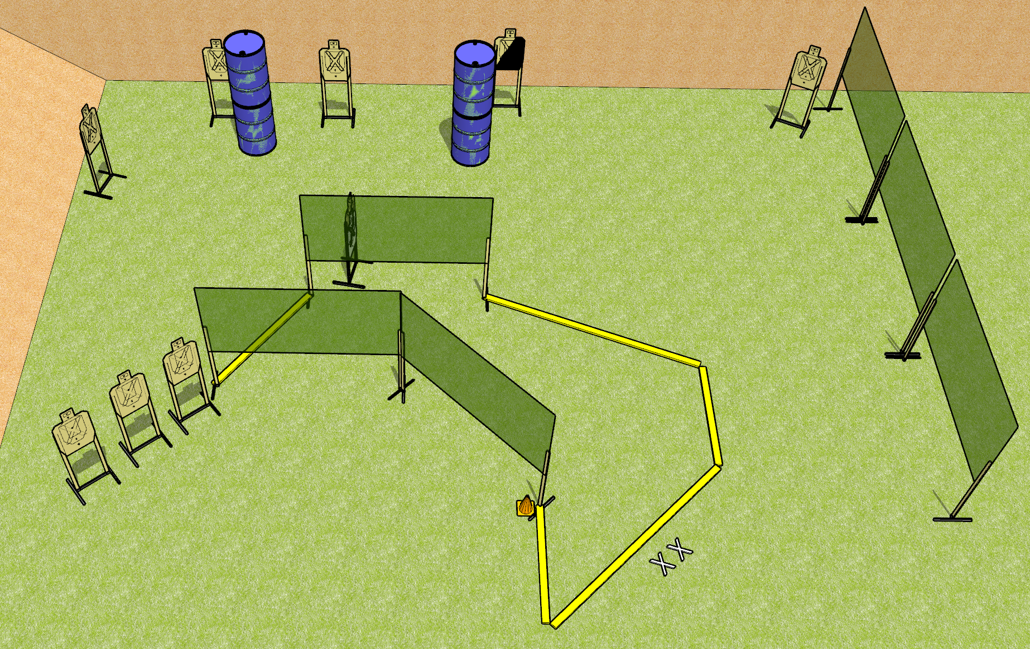
 | Dothan Gun Club – USPSA Match Left Side Boogie Course Designer : Drew Coleman
START POSITION : Standing with both feet on X’s, wrists below belt
GUN READY CONDITION : Pistol loaded and holstered. PCC loaded, shouldered, safety on, pointed at orange cone. |  | SCORING: Comstock, 18 rounds TARGETS: 9 paper, 0 Steel SCORED HITS: Best 2 on paper, steel until down START-STOP: Audible, last shot RULES:
STAGE PROCEDURE: Engage targets as they become available from within the fault lines.

Slide 2
Left Side Boogie
Written Stage Briefing
Left Side Boogie is an 18 round, 90 point, Comstock Medium Course. There are nine USPSA targets. The best two hits on paper will score. The start signal is audible.
Handgun start position is standing with both feet on X’s, toes touching fault line, wrists below belt. Pistol is loaded and holstered.
PCC start position is standing with both feet on X’s, toes touching fault line, muzzle pointed at orange cone. Loaded carbine is held with both hands, shouldered, safety on.
On start signal, engage targets as they become available from within the shooting area.

Slide 3
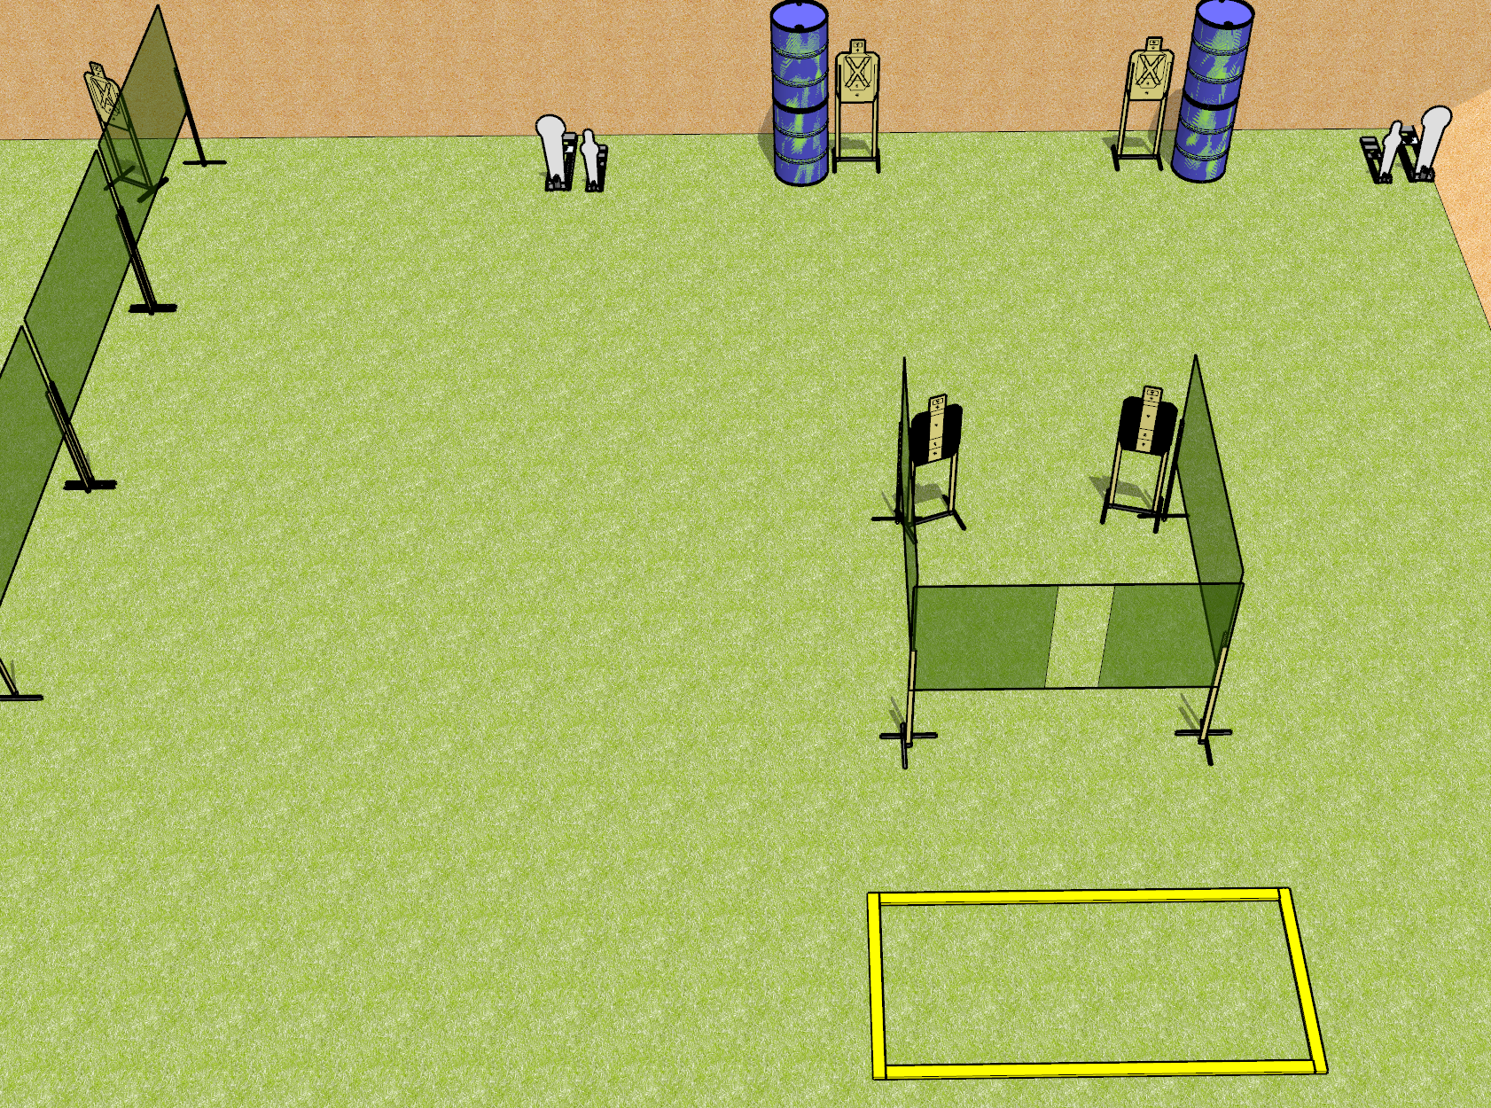
 | Dothan Gun Club – USPSA Match Right Side Boogie Course Designer : Drew Coleman
START POSITION : Anywhere outside the shooting area not touching a fault line, wrists below belt
GUN READY CONDITION : Pistol loaded and holstered. PCC loaded, buttstock on belt, safety on, pointed in a safe direction |  | SCORING: Comstock, 12 rounds TARGETS: 4 paper, 4 Steel SCORED HITS: Best 2 on paper, steel until down START-STOP: Audible, last shot RULES:
STAGE PROCEDURE: Engage targets as they become available from within the fault lines.

Slide 4
Right Side Boogie
Written Stage Briefing
Left Side Boogie is an 12 round, 60 point, Comstock short Course. There are four USPSA targets, two Colt poppers, and two mini poppers. The best two hits on paper will score and steel must fall to score. The start signal is audible.
Handgun start position is standing anywhere outside the shooting area not touching a fault line, wrists below belt. Pistol is loaded and holstered.
PCC start position is standing anywhere outside the shooting area not touching a fault line, muzzle pointed in a safe direction. Loaded carbine is held with both hands, buttstock on belt, safety on.
On start signal, engage targets as they become available from within the shooting area.

